Slide 1
<
6
Chapter 3: Search Trees
2
>
9
1
4
=
8
Notes:
1
1

Slide 2

Binary Search Tree (3.1.2)
A binary search tree is a binary tree storing keys (or key-element pairs) at its internal nodes and satisfying the following property:
  Let u, v, and w be three nodes such that u is in the left subtree of v and w is in the right subtree of v. We have
  key(u) ≤ key(v) ≤ key(w)
External nodes do not store items
An inorder traversal of a binary search trees visits the keys in increasing order
6
2
9
1
4
8

Slide 3
Search in a BST
To search for a key k, we trace a downward path starting at the root
The next node visited depends on the outcome of the comparison of k with the key of the current node
If we reach a leaf, the key is not found and we return a null position
Example: find(4)
Running time is proportional to height h of T, O(h)
Algorithm Treesearch (k, v)
if T.isExternal (v)
  return NO_SUCH_KEY
  if k < key(v)
  return TreeSearch(k, T.leftChild(v))
  else if k = key(v)
  return Position(v)
  else { k > key(v) }
  return TreeSearch(k, T.rightChild(v))
<
6
2
>
9
1
4
=
8

Slide 4
Insertion in a BST
<
6
To perform operation insertItem(k, o), we search for the position to insert key k using TreeSearch(k, T.root())
let w be the leaf reached by the search
If w is an external node ( no item with key k is stored in T)We insert k at node w and expand w into an internal node
Example: insert 5
If w is an internal node(another item with key k is stored), call TreeSearch(T, rightChild(w))
2
>
9
1
4
>
8
w
6
2
9
1
4
8
w
5

Slide 5
If w is an internal node(another item with key k is stored),
  call TreeSearch(k, T.leftChild(w)) (or TreeSearch(k, T.rightchild(w))
  Recursively apply the algo to the node returned by TreeSearch.

Slide 6
Exercise: Binary Search Trees
Insert into an initially empty binary search tree items with the following keys (in this order). Draw the resulting binary search tree
  30, 40, 24, 58, 48, 26, 11, 13

Slide 7
Deletion in a BST
To perform operation removeElement(k), we search for key k
Assume key k is in the tree, and let w be the node storing k
If node w has a leaf child z, we remove w and z from the tree with operation removeAboveExternal(z)
This restructures the tree
  Replaces w by the sibling of z.
  Remove both z and w from T.
Example: remove 4
<
6
2
>
9
1
4
w
8
z
5
6
2
9
1
5
8

Slide 8
Deletion (cont.)
We consider the case where the key k to be removed is stored at a node w whose children are both internal
  we find the internal node y that follows w in an inorder traversal
  we copy key(y) into node w
  we remove node y and its left child z (which must be a leaf) by means of operation removeAboveExternal(z)
Example: remove 3
1
w
3
2
8
6
9
y
5
z
1
y
5
2
8
6
9

Slide 9
Exercise: Binary Search Trees
Insert into an initially empty binary search tree items with the following keys (in this order). Draw the resulting binary search tree
  30, 40, 24, 58, 48, 26, 11, 13
Now, remove the item with key 30. Draw the resulting tree
Now remove the item with key 48. Draw the resulting tree.

Slide 10
Performance
Consider a dictionary with n items implemented by means of a binary search tree of height h
  the space used is O(n)
  methods findElement() , insertItem() and removeElement() take O(h) time
The height h is O(n) in the worst case and O(log n) in the best case

Slide 11
AVL Trees
6
v
3
8
z
4

Slide 12
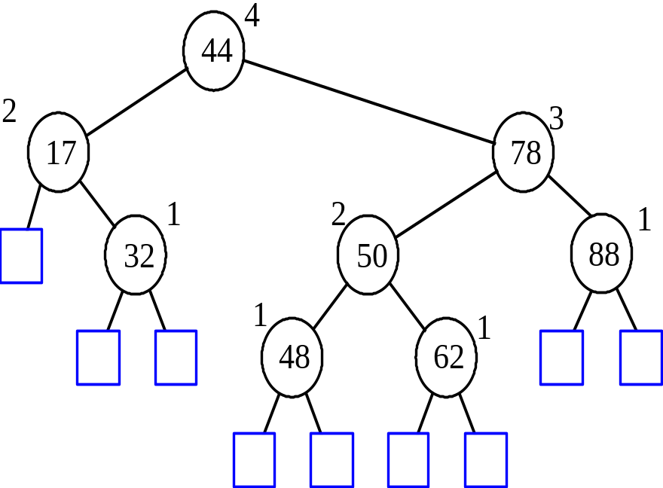
AVL Tree Definition
AVL trees are BST
It has a height-balancing property
For every internal node v of T, the heights of the children of v can differ by at most 1.
Insertion & deletion should preserve this.
Ensures that the depth of the tree is logarithmic
Searches are close to O(log n) and not O(n).
An example of an AVL tree where the heights are shown next to the nodes:

Slide 13
Definition of an AVL tree
Balance Factor of a node in an AVL tree
Representation
Insertion
Height Balancing
Single rotations
  LL and RR
Double Rotations
  LR and RL

Slide 14
Height of an AVL Tree
n(2)
3
4
n(1)
Fact: The height of an AVL tree storing n keys is O(log n).
Proof: Let us bound n(h): the minimum number of internal nodes of an AVL tree of height h.
We easily see that n(1) = 1 and n(2) = 2
For n > 2, an AVL tree of height h contains the root node, one AVL subtree of height h-1 and another of height h-2.
That is, n(h) = 1 + n(h-1) + n(h-2)
Knowing n(h-1) > n(h-2), we get n(h) > 2n(h-2). So
  n(h) > 2n(h-2), n(h) > 4n(h-4), n(h) > 8n(n-6), … (by induction),
  n(h) > 2^{i}n(h-2i)
Solving the base case we get: n(h) > 2 ^{h/2-1}
Taking logarithms: h < 2log n(h) +2
Thus the height of an AVL tree is O(log n)

Slide 15
Insertion in an AVL Tree
Insertion is as in a binary search tree
Always done by expanding an external node.
Example: 54
After insertion, heights of 78 and 44
are imbalanced
(other two cases are symmetrical)
44
case 2: double rotation
(a right rotation about c, then a left rotation about a)
17
78
c=z
a=y
44
32
50
88
17
78
48
62
b=x
32
50
88
54
w
48
62

Slide 16
Trinode Restructuring
let (a,b,c) be an inorder listing of x, y, z
perform the rotations needed to make b the topmost node of the three
(other two cases are symmetrical)
a=z
a=z
case 2: double rotation
(a right rotation about c, then a left rotation about a)
b=y
T₀
c=y
T₀
c=x
b=x
T₃
T₁
b=y
T₁
T₂
b=x
T₂
T₃
a=z
c=x
a=z
c=y
case 1: single rotation
(a left rotation about a)
T₀
T₁
T₂
T₃
T₀
T₁
T₂
T₃

Slide 17
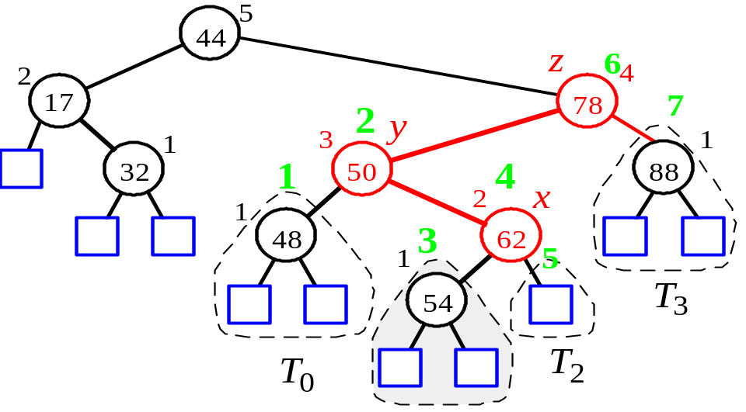
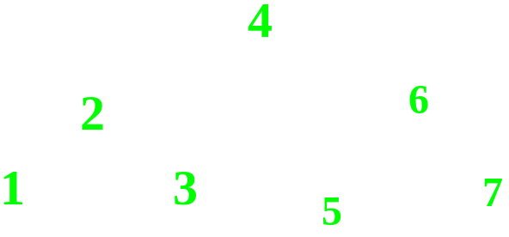
Insertion Example, continued
unbalanced...
T
4
1
44
2
3
x
17
y
62
z
1
2
2
32
50
78
1
1
1
...balanced
48
54
88
T
2
T
0
T
1
T
3

Slide 18
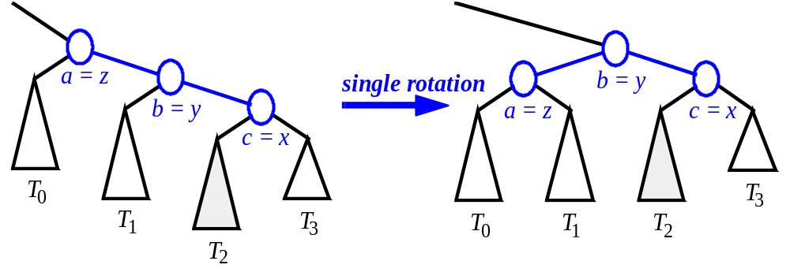
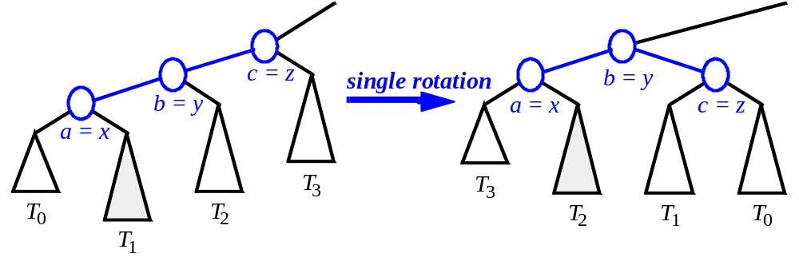
Restructuring (as Single Rotations)
Single Rotations:

Slide 19
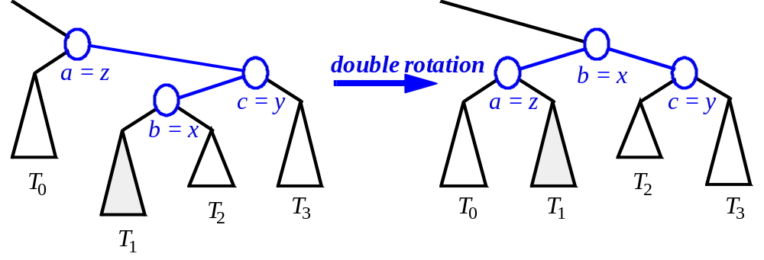
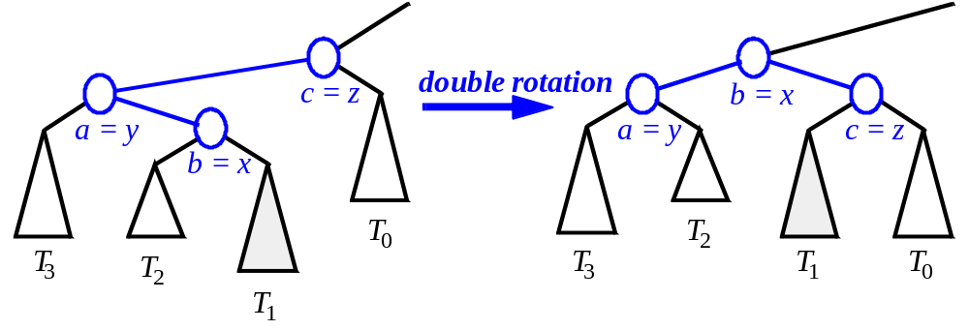
Restructuring (as Double Rotations)
double rotations:

Slide 20
Exercise: AVL Trees
Insert into an initially empty AVL tree items with the following keys (in this order). Draw the resulting AVL tree
  30, 40, 24, 58, 48, 26, 11, 13

Slide 21
Removal in an AVL Tree
Removal begins as in a binary search tree, which means the node removed will become an empty external node. Its parent, w, may cause an imbalance.
Example:
44
remove 32
44
17
62
17
62
32
50
78
50
78
48
54
88
48
54
88
before deletion of 32
after deletion

Slide 22
Rebalancing after a Removal
Let z be the first unbalanced node encountered while travelling up the tree from w (parent of removed node) . Also, let y be the child of z with the larger height, and let x be the child of y with the larger height.
We perform restructure(x) to restore balance at z.
62
a=z
44
44
78
w
17
62
b=y
17
50
∂
88
50
78
c=x
∂
48
54
48
54
88

Slide 23
Rebalancing after a Removal
As this restructuring may upset the balance of another node higher in the tree, we must continue checking for balance until the root of T is reached
  This can happen at most O(log n) times. Why?
62
a=z
44
44
78
w
17
62
b=y
17
50
∂
88
50
78
c=x
∂
48
54
48
54
88

Slide 24
Exercise: AVL Trees
Insert into an initially empty AVL tree items with the following keys (in this order). Draw the resulting AVL tree
  30, 40, 24, 58, 48, 26, 11, 13
Now, remove the item with key 48. Draw the resulting tree
Now, remove the item with key 58. Draw the resulting tree

Slide 25

Running Times for AVL Trees
a single restructure is O(1)
  using a linked-structure binary tree
find is O(log n)
  height of tree is O(log n), no restructures needed
insert is O(log n)
  initial find is O(log n)
  Restructuring up the tree, maintaining heights is O(log n)
remove is O(log n)
  initial find is O(log n)
  Restructuring up the tree, maintaining heights is O(log n)

